Slide 1
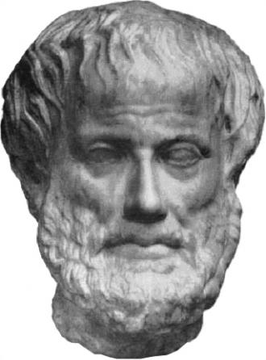
Development of the Field of Biomedical Ontology
Barry Smith
New York State Center of Excellence in Bioinformatics and Life Sciences
University at Buffalo

Slide 2
http://ohd-ontology.org/page/What_constitutes_dental_research

Slide 3
(Compressed) Ontology Timeline
360 BC: Aristotle’s Metaphysics
1879: Invention of modern logic (Boole,
Frege)
1920: The problem of the Unity of Science (Logical Positivism)
1950 Birth of computing

Slide 4
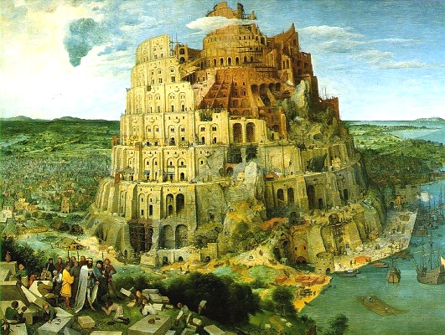

Slide 5
Ontology Timeline (contd.)
1970: AI, Robotics
1980: KIF: Knowledge Interchange Format
1990: Human Genome Project
1999: The Gene Ontology (GO)
2000: Semantic Web (OWL)
2005: Open Biomedical Ontologies (OBO)
2007: National Center for Biomedical Ontology (NCBO) Bioportal

